Slide 1
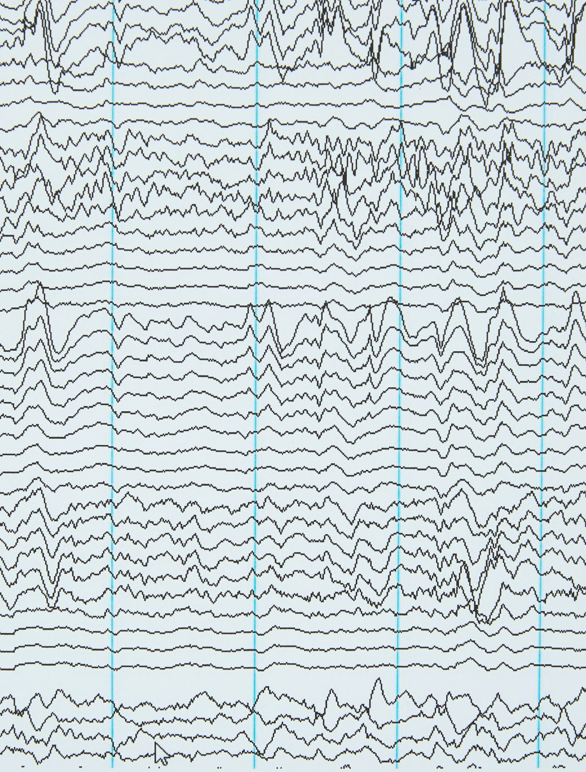
Waveform Generator
Group 3
Tham Seng Joe
Ong Hon Lin

Slide 2

Problem Statements
Growing need for a versatile and user-friendly waveform generator application
Lacking said application that can cater to hobbyist

Slide 3

Problem Solution
Create an application that is intuitive and easy to navigate
Create an application generation of basic waveforms

Slide 4
Objectives
Allow users to generate waveforms
Allow users to input results from .CSV file
Allow users to export result to .CSV file

Slide 5

Features
Read .CSV file as current data input
Generate wave graphs
Export .CSV file as current data output

Slide 6
Thank you

